Slide 1
Smart Job First Dynamic Round Robin (SJFDRR)
Scheduling Algorithm with Smart Time Quantum

Slide 2
The idea of this approach is to make the CPU Scheduler arrange the process in ascending order on the burst time and assign the system priority and calculate a smart priority factor ‘SPF’ for each process.
The process having the smallest ‘SPF’ value will be scheduled first. The time quantum is calculated dynamically. Based on the analysis, we show that the new proposed algorithm (SJFDRR) solves the fixed time quantum problem and increases the performance of Round Robin. v

Slide 3
In proposed plan of work, first we will calculate a smart priority factor ‘SPF’ is for every process.
The process which has smallest ‘SPF’ value will be scheduled first.
In this work every process has two types of priority one is user priority which is given by user itself (PRU) and second is the system priority which is defined by scheduling system in such a way that lowest burst time has highest system priority (PRS).

Slide 4
The two important factors are also taken for calculating smart priority factor (SPF) which is user priority ratio (UPR) and system priority ratio (SPR). The user priority has more importance so the user priority ratio is given 55% weight and system priority ratio is given 45% weight. Suppose that all the processes has arrived at same time i.e. arrival time = 0. Then Smart Priority Factor ‘SPF’ is calculated as
SPF=PRU*UPR+PRS*SPR

Slide 5
Second we will calculate smart time quantum (STQ) which is calculated as
First we will median for the set of processes in ready queue
(b) Then, the smart time quantum is calculated as follows:
Smart Time Quantum (STQ) = (Btmax + M ) /2

Slide 6
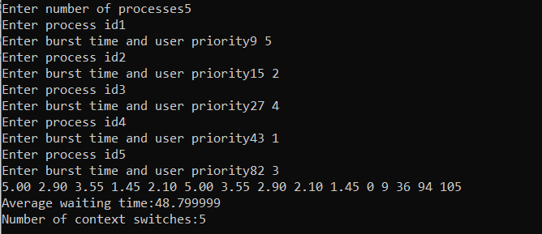
SJFDRR

Slide 7
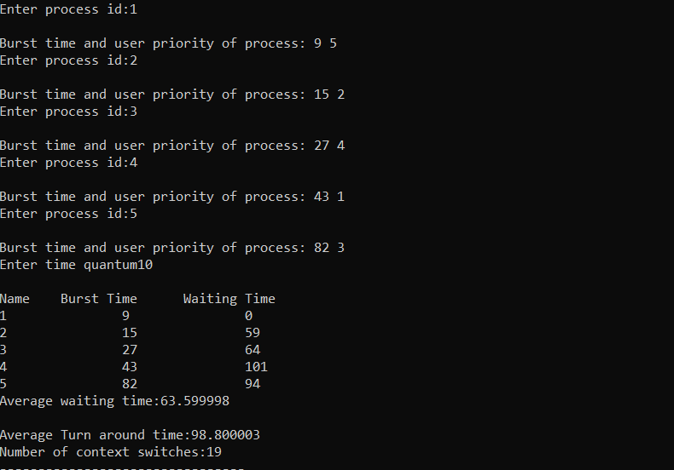
Priority based round robin

